Slide 1
Unity Chess Game
Group 1

Slide 2
The Team
Nadia Cannon
Computer science & computer engineering major
Experience with C, Java, and Python
Fabio Hinojosa Jimenez
Computer science major
Experience with C++, Java, Python, Javascript, and SQL
Shakeeb Rahman
Computer engineering major with a computer science minor
Experience with C
Angelo Figueroa
Computer science major with math minor
Experience with C, Java, & Unity
Lukas Miciunas
Computer science major
Experience with C, C++, Java, Python, and Ruby on Rails

Slide 3
Division of Labor
Angelo Figueroa
Turn timer
Piece movement
Game setup:
Generating board and pieces
Initialize game state
Shakeeb Rahman
Create project roadmap
Fabio Hinojosa Jimenez
Main menu
Lukas Miciunas
Piece classes
Player class
Move validation
Game over screen
Nadia Cannon
Piece capturing
Win state

Slide 4

Getting Started With
Why Unity: Reasons for selecting Unity as the game engine:
Versatile and widely-used game engine
Strong 3D capabilities for rendering and physics
Organized asset management
Portable to a variety of platforms
Large community and extensive learning resources

Slide 5
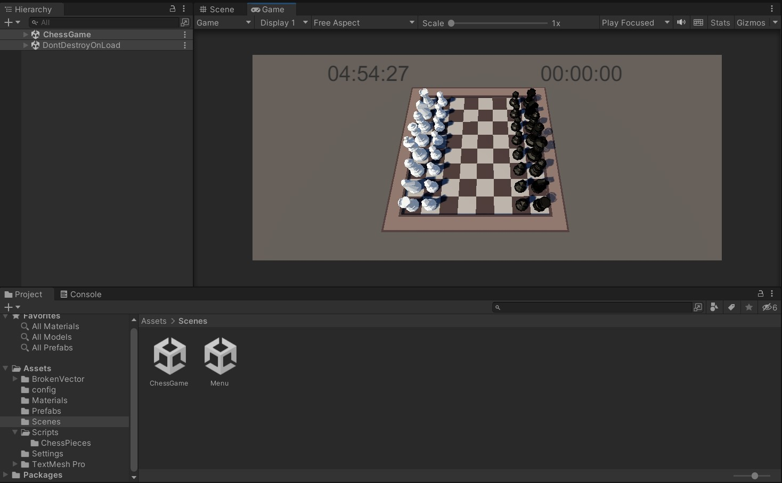
Unity Environment Setup:
Installation of Unity and relevant components
Free personal license to use and publish from Unity
Configuration of the project and scene settings such as the camera and game object hierarchy
Familiarization with the Unity editor and workspace

Slide 6
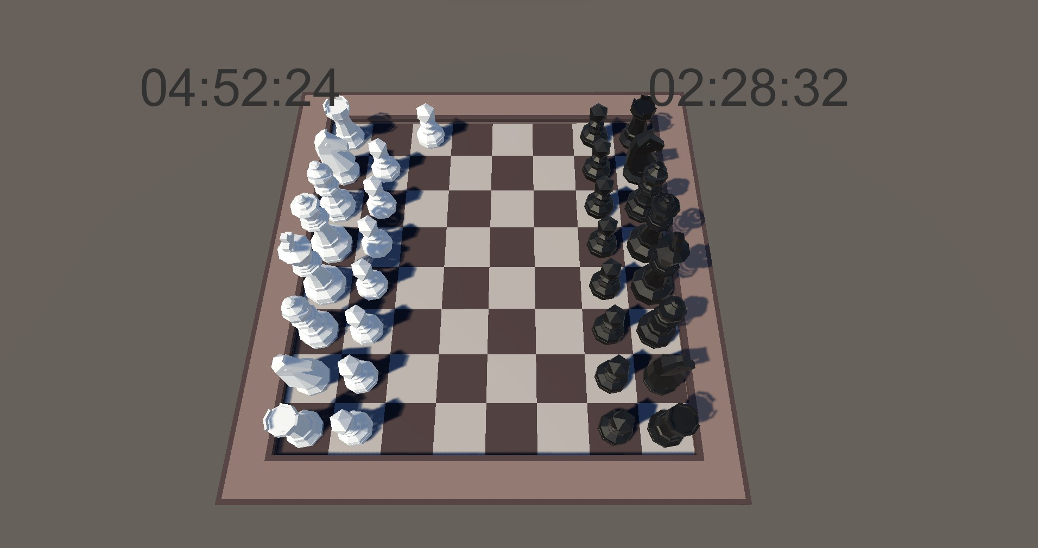
Key Unity Features Used in the Project:
Unity's Prefabs for efficient use of game objects (LowPolyChessPack*)
Prefabs include Colliders and Renderers for realistic piece movement and collision
Scenes organize the different screens presented to the player
Scripting with C# for game logic and interactions
Unity's UI system for creating main menu, buttons, and timer display
* https://assetstore.unity.com/packages/3d/props/low-poly-chess-pack-50405

Slide 7
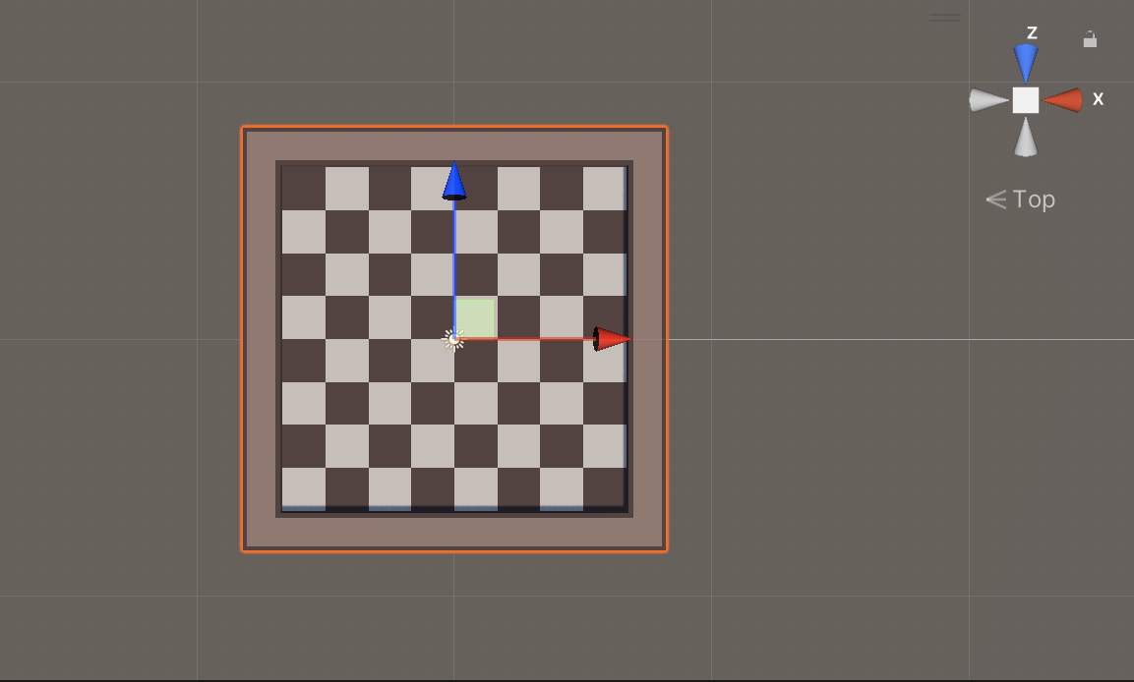
Game Design
Board Setup and Initialization Process
Instantiating Prefab Objects
Initializing array of tiles overlaid on the board to create spaces
Placing pieces on the board in their correct starting positions

Slide 8
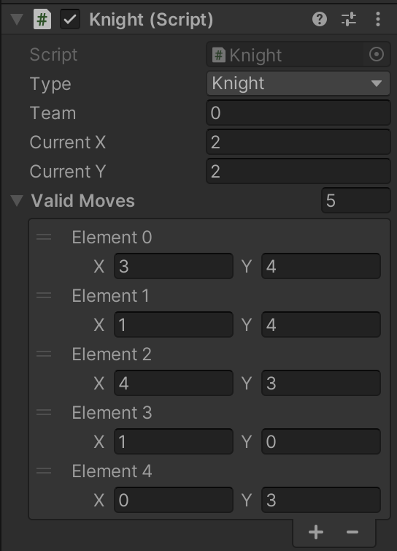
Game Design
After initialization, and after every move, pieces update their validMoves list
Move input is done by dragging pieces with the mouse
A ray is emitted from the tip of the mouse, and returns any piece object intersecting it
When a piece is released the move is completed if the destination tile is contained in the pieces’ validMoves list

Slide 9

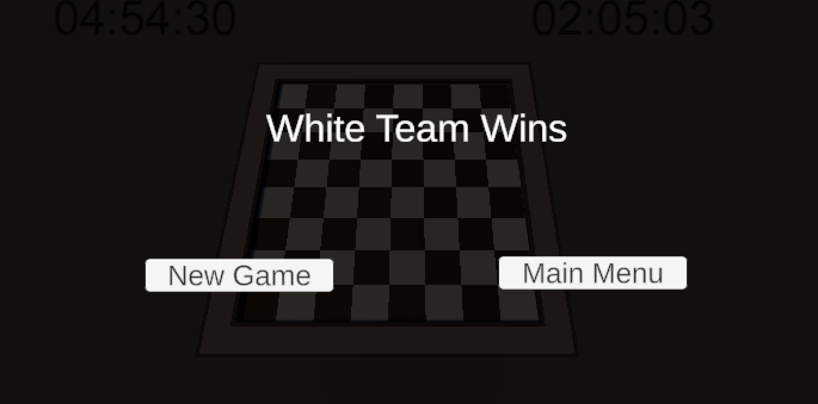
Game Design
Designing the main menu layout with "Play" and "Quit" buttons
Game over screen allows user to start a new game, or return to the main menu

Slide 10
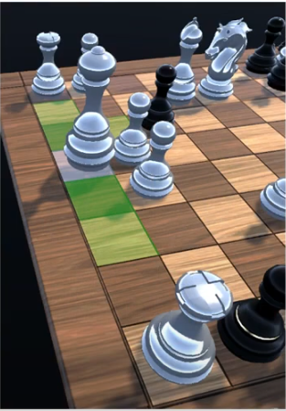
Challenges faced
Learning curve with Unity tools, scripting, and concepts like GameObjects and
components
Difficulties in implementing specific game mechanics or features
(e.g., collision detection, piece movement, move validation)
Difficulty incorporating AI in the game

Slide 11
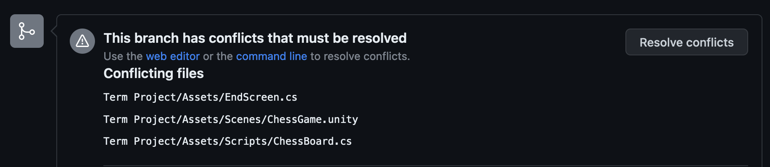
Challenges faced
Poor encapsulation
Did not establish strict boundaries for classes
Overlapping functionality in our separate contributions
Merging remote branches on Github and resolving conflicts

Slide 12
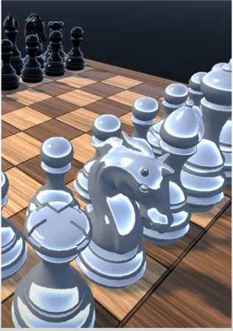
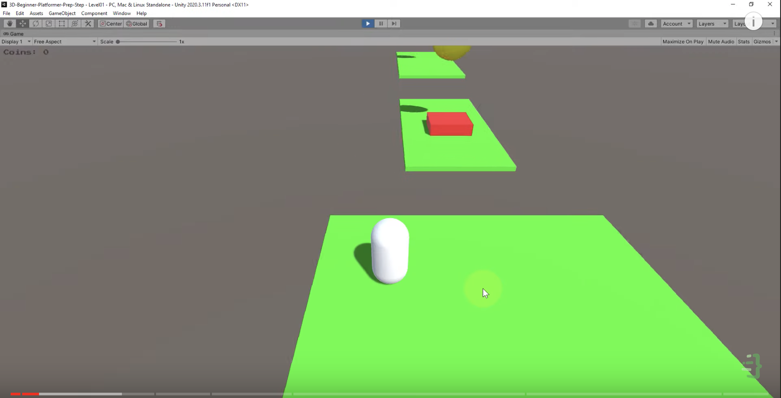
Solutions and Workarounds:
Researching solutions through Unity documentation, forums, and tutorials
Seeking feedback and advice from peers or mentors
Adapting designs or features to overcome constraints and limitations
Sacrificing readability and maintainability for function
Build Your First 3D Game in Unity 10 part series
Coding In Flow - Youtube

Slide 13
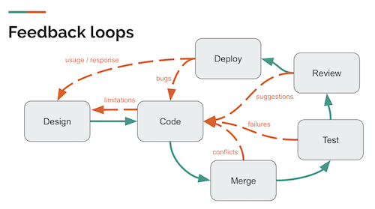
Testing and feed-back
Playtesting - testing functionality by playing the game as a user
Identifying and fixing bugs in game mechanics, UI, and performance
Ensuring compatibility across different devices (PC and Mac)
Key Takeaways from Playtesting:
Simpler to drag-and-drop pieces than to select/deselect
Piece capturing and win-state check logic conflicted
We needed more concrete plans for our functions before getting started

Slide 14
Future Enhancements
Multiplayer Functionality and AI Opponent:
Expanding the game to include online multiplayer options
Implementing AI algorithms for intelligent and engaging gameplay that uses some sort of Algorithm (minmax)
Adding special moves (e.g castling, en-passant)
Adding animations to piece movement
Option to surrender
Finishing check validation
As it stands a player must actually capture the opposing King, or run out of time on their turn clock in order to end the game.

Slide 15

Demonstration:

